Slide 1
VITCare: make a vas deferens in lives
A DATA STRUCTURE AND ALGORITHM J-COMPONENT

Slide 2
What is it?
An All Purpose Medical Facility Management System
A J-COMPONENT FOR DATA STRUCTURES AND ALGORITHM

Slide 3
Content
01
Team Details
Information on people behind the project.
02
Introduction
Inspiration behind making of project
03
Modules
Specifications of different parts of the J-component.
04
Progress
Detailed Information of development of idea.

Slide 4

Our Team Infographic
1.ARYAMAN MISHRA->Chatbot Designing.
2.ARJUN NAIR->C program for medical supplies management system
3.CLIVIN JOHN GEJU->ML for Symptom Checker
4.HARSANTH KP-> Creating a basic webpage design for user interaction

Slide 5
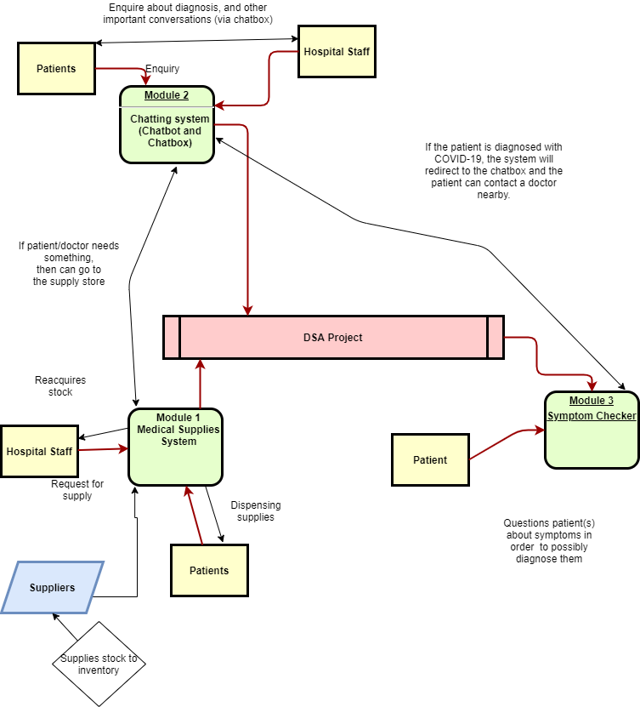

Slide 6
Introduction
“A man ate a bat and now I cannot go to my favourite restaurant,A man ate a bat and I can’t eat a pizza by home delivery.A man ate a bat and I have to stare at a screen for 12 hours a day and my sleep schedule has been utterly destroyed.”
-Anonymous Student
In India, the Covid-19 deaths per million population stand at 20.4 per million(subject to change) which is amongst the lowest in the world.Our Prime Minister enforced a lockdown which at a certain degree was the correct movie.The patients being brought in to various medical facilities took a toll over the administration and the entire system in various systems just broke down.Lives were lost due to sheer recklessness on doctor’s part and some were made to suffer due to lack of resources.
The reason for low supplies in hospital is that the system is too complex and also requires a person to go blind on paperwork related to supplies.Private hospitals which admits less patients have supplies in abundance which are not being used due to high admission rates and civil hospitals are being overcrowded with people who are not getting oxygen cylinders,attention or medicines to stablilize their pitiful conditions.
Our project which has functionalitites to last beyond this ‘pandemic era’ allows for simple ordering of medical supplies and equipments using stacks and arrays for a single medical facility.In addition,we integrate an interactive UI which helps in easy establishment of communication behind program and user.Our users include both medical staff and patients.In addition,we provide a medical staffer to update the list of items and provide payment options for purchasing with a calculated amount by way of material and quantity.
We have included a chatbot which caters to both users and doctors by giving appointments,assigning ambulances and providing details on driver,state and estimated time of arrival including other necessary hands-on information.
There’s a symptom checker built for particularly the novel COVID-19 which takes necessary details on patients and gives a probability of if a person has been infected with the virus and upto which level is he in danger of having contracted the virus.

Slide 7

Website to link our modules

Slide 8

Chatbot
The Chatbot(NAME TBA) uses responses stored in an array to respond to various queries. It also gives pre-defined options for smoother user interaction.
Introduction
This is the hospital bot.It will provide contacts,find doctors reception schedule,make or cancel an appointment with a doctor.It can also call an ambulance if needed,
Reception Schedule
The reception schedule goes beyond the pandemic and offers to make appointments with surgeons,pediatricians and even gynaecologists.
Contacts
You can get the work hours of a facility and get an option to call a reception or administrating officer..
Others
You can call an ambulance,get a quote to keep your spirits up,call up the symptom checker.More updates will be rolled out over the progress eventually.

Slide 9
A tree can be “learned” by splitting the source set into subsets based on an attribute value test. This process is repeated on each derived subset in a recursive manner called recursive partitioning. The recursion is completed when the subset at a node all has the same value of the target variable, or when splitting no longer adds value to the predictions. The construction of decision tree classifier does not require any domain knowledge or parameter setting, and therefore is appropriate for exploratory knowledge discovery. Decision trees can handle high dimensional data. In general decision tree classifier has good accuracy. Decision tree induction is a typical inductive approach to learn knowledge on classification.
Decision trees classify instances by sorting them down the tree from the root to some leaf node, which provides the classification of the instance. An instance is classified by starting at the root node of the tree,testing the attribute specified by this node,then moving down the tree branch corresponding to the value of the attribute as shown in the above figure.This process is then repeated for the subtree rooted at the new node.

Slide 10
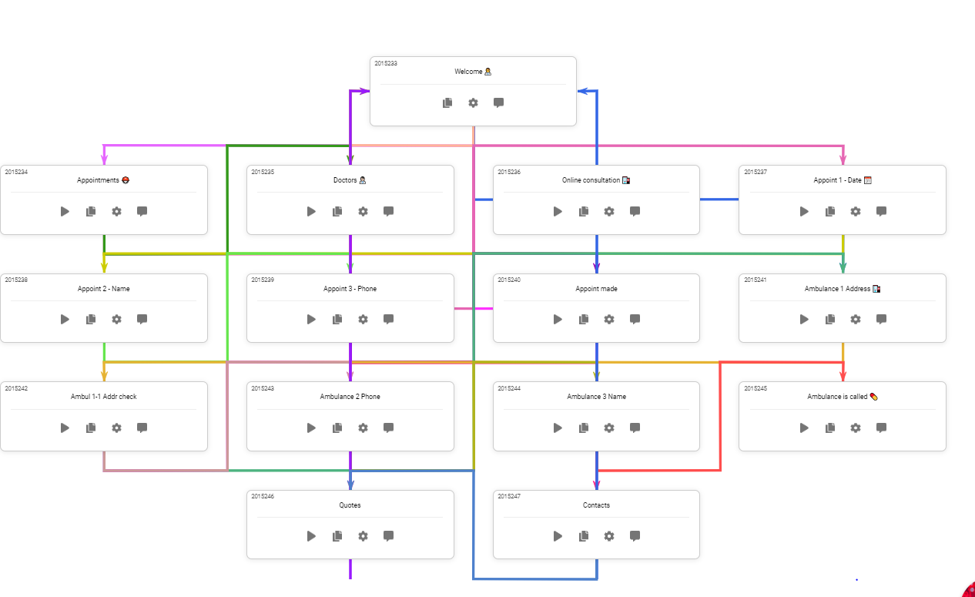
Decision Tree Layout Used in Chatbot

Slide 11
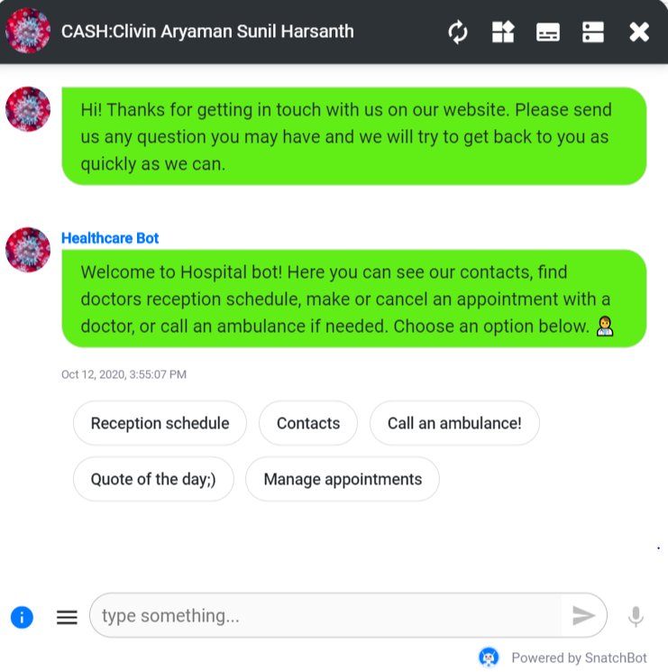


Slide 12
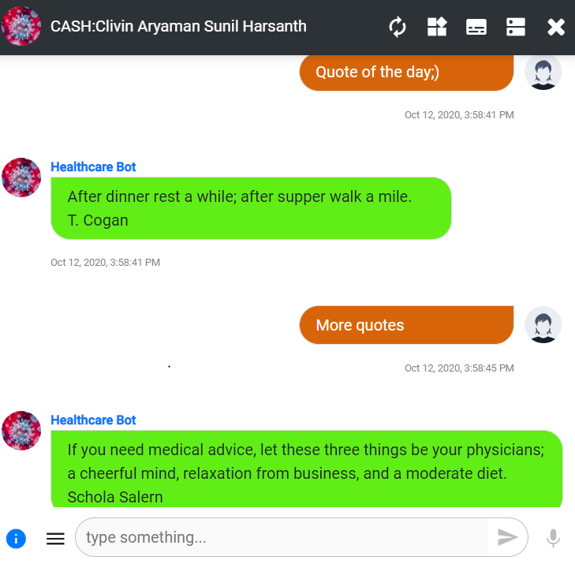
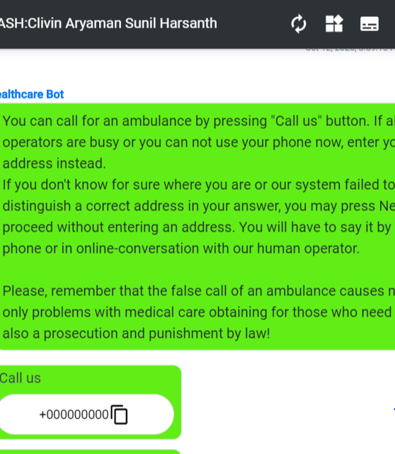

Slide 13
Medical Supplies Management System
We will be making a C program to support the medical supplies management system which will be implemented using stack and SLL data structure/ADT . We will provide a program in which medical supplies with their stock and cost will be displayed for the user from which any of the items of any quantity(until stock runs out) can be bought and the payment can be done through cash or credit card . The stock and prices can be updated by the admin by accessing the admin panel.
This system is very helpful for patients to buy medicines and supplies such as masks and medical personnel such as doctors to refer the stock to prescribe required medicines to the patients and to order inventory for the hospital from the list.
This program can also be integrated with the chat bot so that the doctor or medical personnel can redirect a patient to buy the prescribed medicine or to look over the stock of medical supplies present in the hospital.
The SLL ADT is used to store the medicines and medical items in the list from which the user can select the products/

Slide 14
Program Code
Please find code for Medical Management System where we have used Singly Linked List for updating product supplies list:
In case of corrupted file,please refer to the code given below: (Blurred lines is code in font size 1)
#include<stdio.h>
#include<stdlib.h>
#include<conio.h>
#include<string.h>
#include<windows.h>
#include<time.h>
///Logic Functions
/// Update & Insert Function
void insertfirst(int data, char supplies[25], int quantity, float price);
void insertmid(int pos, int data, char supplies[25], int quantity, float price);
void insertend(int data, char supplies[25], int quantity, float price);
void updatesupply(int udata, int uquantity);
/// Display Function
void supplylist();
void order_view(int order, int quantity, int or_no);
void main_menu();
///Delete & Count Function
void deletesupply(int serial);
int countitem();
///extra design Function
void cls();
void echo(char print[]);
void br(int line);
void pre(int tab);
void span(int space);
void ccolor(int clr);
void pwellcome();
void loadingbar();
void middle1(void);
void middtab1(void);
void backuploader(void);
///START Structure Here
struct Node{
char supplies[50];
int quantity;
float price;
int data;
struct Node *next;
};
///Global Type
typedef struct Node node ;
node *head, *list;
int main(){
system("mode con: cols=80 lines=30");
loadingbar(); cls();
pwellcome();
Sleep(300);
cls();
int c=0; int any;
int cardno[100];
float cardmoney[100];
float totalmoney = 0;
int total_order[100];
int order_quantity[100];
int order=0;
int uquantity;
int citem;
head = NULL;
insertfirst(5,"Masks",23,120.23);
insertend(6,"Syringes",13,100.67);
insertend(1,"Cough Syrups",8,720.83);
insertend(2,"First Aid Kits",46,70.23);
insertend(3,"Hazmat Suits",46,70.23);
insertend(4,"Stethoscope",34,60.23);
insertend(7,"Thermometer",7,520.29);
insertend(8,"Antibiotics",121,35.13);
insertend(9,"Antiseptics",73,20.13);
mainmenu:
br(1);
main_menu();
int main_menu_choice;
br(1); pre(4); fflush(stdin); scanf("%d",&main_menu_choice);
if((main_menu_choice >=1 && main_menu_choice <=3)){
if(main_menu_choice == 1){
supplylist:
cls();
printf("=> 0. Main Menu ");
supplylist();
}
else if( main_menu_choice == 2){
adminpanelchoice:
int admin_panel_choice;
cls(); middle1() ; pre(4); printf("1. Main Menu\n\n\t"); Sleep(300);
printf("Please Enter Password or ( 1 to Back in Main Menu ) : ");
fflush(stdin); scanf("%d",&admin_panel_choice);
if(admin_panel_choice==123321){
node *temp;
temp = list;
adminchoise:
cls(); br(5); pre(4); echo("You are on Admin Pannel\n\n");
pre(4);
printf(" 1. Total Cash Today \n\n");Sleep(250);pre(4);
printf(" 2. View Card Pay \n\n");Sleep(250);pre(4);
printf(" 3. Add supply \n\n");Sleep(250);pre(4);
printf(" 4. Delete Supply \n\n");Sleep(250);pre(4);
printf(" 5. Instant supply List \n\n");Sleep(250);pre(4);
printf(" 6. Item Counter \n\n");Sleep(250);pre(4);
printf(" 7. Backup System\n\n");Sleep(250);pre(4);
printf(" 8. Instant Order Preview\n\n");Sleep(250);pre(4);
printf(" 0. Main Menu ");Sleep(250);
int adminchoise;
fflush(stdin); scanf("%d",&adminchoise);
if(adminchoise==1){
cls(); middle1(); pre(4); printf("Todays Total Cash : %0.2f \n",totalmoney);
Sleep(2000);
goto adminchoise;
}
else if(adminchoise==2){
if(c!=0){
cls(); br(3); pre(4);
printf(" ____________________________\n");pre(4);
printf("| Card NO. | Money $ |\n");pre(4);
printf("------------------------------\n");pre(4);
for(int z=1; z<=c;z++){
printf("| %d | %0.2f |\n",cardno[z],cardmoney[z]);pre(4);
printf("------------------------------\n");pre(4);
Sleep(150);
}
Sleep(1500);
}
if(c==0){
cls(); middle1(); pre(4);
printf("No Card History\n");}
Sleep(1500);
goto adminchoise;
}
else if(adminchoise==3){
supplyadd:
cls();
char fsupplies[25];
int fquantity;
int fdata;
float fprice;
int fposi;
br(3);pre(4); printf(" Enter Supply Name : ");
fflush(stdin); scanf("%[^\n]s",fsupplies);
fquantity:
fflush(stdin);
br(2);pre(4); printf(" Enter Supply Quantity : ");
scanf("%d",&fquantity); fflush(stdin);
supplyserial:
br(2);pre(4); printf(" Enter Supply Serial : ");
scanf("%d",&fdata);
node *exist;
exist = list;
while(exist->data!=fdata){
if(exist->next==NULL){
break;
}
exist=exist->next;
}
if(exist->data==fdata){
cls(); br(5);pre(3); printf(" Supply Serial Already Exist, Please Re-Enter "); Sleep(2000);
goto supplyserial;
}
fprice:
fflush(stdin);
br(2);pre(4); printf(" Enter Supply Price : ");fflush(stdin);
scanf("%f",&fprice);
br(2);pre(4); printf("Submiting your data");for(int cs=0;cs<4;cs++){printf(" .");Sleep(500);}
insertend(fdata,fsupplies,fquantity,fprice);
br(2);pre(4); printf("Adding supply Successfull....\n");
Sleep(2000);
goto adminchoise;
}
else if(adminchoise==4){
cls();
middle1();pre(2);
printf("Enter Serial No of the supply To Delete : ");
fdelete:
int fdelete;
fflush(stdin); scanf("%d",&fdelete);
node *temp;
temp=list;
while(temp->data != fdelete){
temp = temp->next;
}
if(temp->data==fdelete){
deletesupply(fdelete);
}
else{
br(2); pre(2); printf("Please Enter Correct Number : "); Sleep(500);
goto fdelete;
}
goto adminchoise;
}
else if(adminchoise==5){
cls(); supplylist(); Sleep(1000);
br(2);pre(4); printf("1. <-- back \n\n");pre(5);
fflush(stdin); scanf("%d",&any);
goto adminchoise;
}
else if(adminchoise==6){
citem = countitem();
cls();
for(int cs=1;cs<=citem;cs++){
middle1(); pre(4);
printf("Item Counting ");
printf(" %d ",cs);
Sleep(150);
cls();
}
cls();
middle1();pre(4);
printf("Total Supply Item is --> %d \n",citem); Sleep(2000);
goto adminchoise;
}
///Backup System
else if(adminchoise==7){
char date[35]=__DATE__;
strcat(date,".txt");
FILE *fptr;
fptr=fopen(date,"w");
backuploader();
if(fptr==NULL){
br(3); pre(3); printf("Error!"); Sleep(500);
goto adminchoise;
}
fprintf(fptr,"Total Cash Today : %0.2f\n\n\n",totalmoney);
fprintf(fptr,"Card No ------- Money \n\n");
for(int l=1; l<=c;l++){
fprintf(fptr,"%d ------- %0.2f \n",cardno[l],cardmoney[l]);
}
br(2);pre(4); printf("Backup Successfull..."); Sleep(1500);
fclose(fptr);
goto adminchoise;
}
else if(adminchoise==8){
cls();br(2);pre(2);
ccolor(26);
printf("\n\t\t"); ccolor(240);
printf("______________________________________________________ "); ccolor(26);
printf("\n\t\t"); ccolor(240);
printf("| Order No. | Supply Name | Quantity | In Stock |"); ccolor(26);
printf("\n\t\t"); ccolor(240);
printf("------------------------------------------------------"); ccolor(26);
for(int o=1;o<=order;o++){
order_view(total_order[o],order_quantity[o],o);
}
br(2);pre(4); printf("1. <-- back \n\n");pre(5);
fflush(stdin); scanf("%d",&any);
goto adminchoise;
}
else if(adminchoise==0){
goto mainmenu;
}
else{
br(2); pre(4); printf("Please Select From List : "); Sleep(500);
goto adminchoise;
}
}
else if(admin_panel_choice==1){
goto mainmenu;
}
else{
br(2); pre(4); printf("Please Enter Correct Choice");
goto adminpanelchoice;
}
}
else if(main_menu_choice==3){
cls();
middle1(); pre(3); printf("Thank You For Using Our System \n\n\n\n\n\n\n");
Sleep(1000);
exit(1);
}
}
else{
br(2); pre(4); printf("Please Enter Correct Choice"); Sleep(300);
goto mainmenu;
}
int get_supply_choice;
br(2); pre(3);fflush(stdin); printf("Place Your Order: ") ; scanf("%d",&get_supply_choice);
if(get_supply_choice==0){
goto mainmenu;
}
node *temp;
temp = list ;
while(temp->data != get_supply_choice){
temp = temp->next;
if(temp==NULL){
br(2); pre(4); echo("Please Choice From List "); br(2); Sleep(1000);
goto supplylist;
}
}
if(get_supply_choice == temp->data){
fcquantity:
br(2); pre(4); printf("Enter Supply Quantity : ");
int fcquantity;
fflush(stdin); scanf("%d",&fcquantity); cls();
if(fcquantity==0){
cls(); middle1();pre(3); printf("Quantity Can not be Zero "); Sleep(2000);
cls();
goto supplylist;
}
else if(fcquantity>temp->quantity){
cls(); middle1();pre(3); printf("Out of Stock ! "); Sleep(2000);
goto supplylist;
}
middle1();pre(4); printf("Choice Supply %s its price is %0.2f \n\n",temp->supplies,temp->price*fcquantity);pre(4);
printf("1. Confirm to buy this \n\n");pre(4);
printf("2. supply List ");
confirm:
int confirm;
fflush(stdin); scanf("%d",&confirm);
if(confirm == 1 ){
br(2);pre(4); printf(" 1. Cash ");
br(2);pre(4); printf(" 2. Credit ");
payment:
int payment;
fflush(stdin); scanf("%d",&payment);
if(payment==1){
totalmoney += temp->price*fcquantity;
order++;
total_order[order]=get_supply_choice;
order_quantity[order]=fcquantity;
uquantity = temp->quantity - fcquantity;
updatesupply(get_supply_choice,uquantity);
cls();middle1();pre(4); printf("===>THANK YOU<===");
br(2);pre(4); printf("Supply Ordered Successfully ...");
br(2);pre(4); printf("1. Wanna Buy Another Medical Item ? ");
br(2);pre(4); printf("2. Main Menu ");
psmenu:
int ps_menu;
fflush(stdin); scanf("%d",&ps_menu);
if(ps_menu==1){goto supplylist;}
else if(ps_menu==2){goto mainmenu;}
else{br(2);pre(4);printf("Please Choice from list : "); goto psmenu;}
}
///Credit Card Option
else if(payment==2){
int card_number[100];
c++;
cls();middle1();pre(4); printf("Enter Your Card No : ");
fflush(stdin); scanf("%d",&card_number[c]);
cardno[c] = card_number[c];
int pin;
br(2);pre(2); printf("Enter Your Card Pin [we never save your pin] : ");
fflush(stdin); scanf("%d",&pin);
cardmoney[c] = temp->price*fcquantity;
totalmoney += temp->price*fcquantity;
order++;
total_order[order]=get_supply_choice;
order_quantity[order]=fcquantity;
uquantity = temp->quantity - fcquantity;
updatesupply(get_supply_choice,uquantity);
br(2);pre(4); printf("Payment Success...");
br(2);pre(4); printf("1. Wanna Buy Another Medical Item ? ");
br(2);pre(4); printf("2. Main Menu ");
psmenu2:
int ps_menu2;
scanf("%d",&ps_menu2);
if(ps_menu2==1){goto supplylist;}
else if(ps_menu2==2){goto mainmenu;}
else{br(2);pre(4);printf("Please Choice from list : "); goto psmenu2;}
}
else{
br(2);pre(4); printf("Enter Choice from List : ");
goto payment;
}
} ///END Confirm Y/y
else if(confirm == 2){
goto supplylist;
}
else{
br(2);pre(4); printf("Enter Choise from List : ");
goto confirm;
} ///end confirm;
} ///end get supply choice if line
else{
br(2);pre(4); echo("Please Choice From List "); br(2); Sleep(300);
goto supplylist;
} ///end get supply choice
}
void cls(){
system("cls");
}
void echo(char print[]){
printf("%s",print);
}
void br(int line){
for(int i=0; i<line;i++){
printf("\n");
}
}
void pre(int tab){
for(int i=0; i<tab;i++){
printf("\t");
}
}
void span(int space){
for(int i=0; i<space;i++){
printf(" ");
}
}
void main_menu(){
cls();
br(5); pre(3); echo("===> 1. Supply List"); Sleep(400);
br(2); pre(3); echo("===> 2. Admin Panel"); Sleep(400);
br(2); pre(3); echo("===> 3. Exit"); Sleep(400);
// br(2); pre(3); echo("=> 4. Admin Panel"); Sleep(400);
br(1);
}
void insertend(int data, char supplies[25], int quantity, float price){
node *temp;
temp=(node *)malloc(sizeof(node));
temp->data = data;
temp->price = price;
temp-> quantity = quantity;
strcpy(temp->supplies,supplies);
temp->next = NULL;
if(head==NULL){
head = temp;
list = head;
}
else{
while(head->next != NULL){
head = head->next;
}
head->next = temp;
}
}
void insertfirst(int data, char supplies[25], int quantity, float price){
node *temp;
temp=(node *)malloc(sizeof(node));
temp->data = data ;
temp->price = price;
strcpy(temp->supplies,supplies);
temp-> quantity = quantity;
temp->next = head;
head = temp;
list = head ;
}
void insertmid(int pos, int data, char supplies[25], int quantity, float price){
node *temp;
temp=(node *)malloc(sizeof(node));
temp->data = data;
temp->price = price;
temp-> quantity = quantity;
strcpy(temp->supplies,supplies);
while(head->next->data != pos ){
head = head->next ;
}
temp->next = head->next;
head->next = temp ;
// free(temp);
}
void deletesupply(int serial){
node *temp;
temp=(node *)malloc(sizeof(node));
temp = list;
if(temp->data != serial){
while(temp->next->data != serial){
temp = temp->next;
}
if(temp->next->data == serial){
temp->next = temp->next->next;
cls();
printf("\n\n\n\n\t\t\tDeleting Item %d ",serial);for(int cs=0;cs<4;cs++){printf(" .");Sleep(400);}
printf("\n\n\n\n\t\t\tDeleted Successfylly \n"); Sleep(500);
}
else{
printf("\n\n\n\n\t\t\tsupply Item Not Found\n"); Sleep(500);
}
head = temp ;
}
else{
temp = temp->next;
cls();
printf("\n\n\n\n\t\t\tDeleting Item %d ",serial);for(int cs=0;cs<4;cs++){printf(" .");Sleep(400);}
printf("\n\n\n\n\t\t\tDeleted Successfylly \n"); Sleep(500);
head = temp ;
list=head;
}
}
void updatesupply(int udata, int uquantity){
node *temp;
temp = list;
while(temp->data!=udata){
temp = temp->next;
}
if(temp->data == udata){
temp->quantity = uquantity;
}
}
int countitem(){
node *temp;
temp = list;
int countitem=0;
if(temp==NULL){
countitem = 0;
}
else{
countitem = 1;
while(temp->next != NULL){
countitem++;
temp = temp->next;
}
}
return countitem;
}
void supplylist(){
ccolor(26);
printf("\n\t\t"); ccolor(240);
printf("______________________________________________________ ");ccolor(26);
printf("\n\t\t"); ccolor(240);
printf("| supply No. | supply Name | Price | In Stock |");ccolor(26);
printf("\n\t\t"); ccolor(240);
printf("-------------------------------------------------------");ccolor(26);
node *temp;
temp = list;
while(temp != NULL){
ccolor(26);
printf("\n\t\t"); ccolor(62);
printf("| %d | %s | %0.2f | %d |",temp->data,temp->supplies, temp->price, temp->quantity);
ccolor(26);
printf("\n\t\t"); ccolor(62);
printf("-------------------------------------------------------");
temp = temp->next ;
Sleep(100);
}
ccolor(26);
// free(temp);
}
void order_view(int order, int quantity, int or_no){
ccolor(26);
node *temp;
temp = list;
while(temp->data != order){
temp = temp->next;
}
if(temp->data == order){
ccolor(26);
printf("\n\t\t"); ccolor(62);
printf("| %d | %s | %d | %d |",or_no,temp->supplies,quantity,temp->quantity);
ccolor(26);
printf("\n\t\t"); ccolor(62);
printf("-------------------------------------------------------");
Sleep(100);
}
ccolor(26);
}
void ccolor(int clr){
HANDLE hConsole;
hConsole = GetStdHandle(STD_OUTPUT_HANDLE);
SetConsoleTextAttribute(hConsole, clr);
}
///HEERE PRINTF STYLE FUNCTION
void pwellcome(){
ccolor(26);
char welcome[50]="WELCOME";
char welcome2[50]=" TO";
char welcome3[50]=" MEDICAL SUPPLY ORDER";
char welcome4[50]=" MANAGEMENT SYSTEM";
printf("\n\n\n\n\n\t\t\t");
for(int wlc=0; wlc<strlen(welcome);wlc++){
ccolor(120+(wlc*9));
printf(" %c",welcome[wlc]);
Sleep(200);
}
ccolor(26);
printf("\n\n\t\t\t\t ");
for(int wlc2=0; wlc2<strlen(welcome2) ;wlc2++){
ccolor(160+(wlc2*9));
printf(" %c",welcome2[wlc2]);
Sleep(200);
}
ccolor(26);
printf("\n\n\n\t\t\t ");
for(int wlc3=0; wlc3<strlen(welcome3) ;wlc3++){
if(welcome3[wlc3]!='D'){
ccolor(121+(wlc3*4));
printf(" %c",welcome3[wlc3]);
}
else{
ccolor(11);
printf(" %c",welcome3[wlc3]);
}
Sleep(200);
}
ccolor(26);
printf("\n\n\n\t\t\t\t ");
for(int wlc3=0; wlc3<strlen(welcome4) ;wlc3++){
if(welcome4[wlc3]!='A' && welcome4[wlc3]!='E'){
ccolor(121+(wlc3*4));
printf(" %c",welcome4[wlc3]);
}
else{
ccolor(11);
printf(" %c",welcome4[wlc3]);
}
Sleep(200);
}
ccolor(26);
}
void loadingbar(void){
for (int i=15;i<=100;i+=5){
cls();
ccolor(26);
printf("\n\n\n\n\n\n\n\t\t\t\t");
printf("%d %% Loading...\n\n\t\t",i);
printf("");
for (int j=0; j<i;j+=2){
ccolor(160+j);
printf(" ");
ccolor(26);
}
Sleep(100);
if(i==90 || i==50 || i==96 || i==83){
Sleep(100);
}
}
}
void backuploader(void){
for (int i=15;i<=100;i+=5){
cls();
ccolor(26);
printf("\n\n\n\n\n\n\n\t\t\t\t");
printf("%d %% Backing UP DATA...\n\n\t\t",i);
printf("");
for (int j=0; j<i;j+=2){
ccolor(120+j);
printf(" ");
ccolor(26);
}
Sleep(50);
if(i==90 || i==50 || i==96 || i==83){
Sleep(50);
}
}
}
void middle1(void){
printf("\n\n\n\n\n\n\n");
}
void middtab1(void){
printf("\t\t\t\t\t");
}

Slide 15
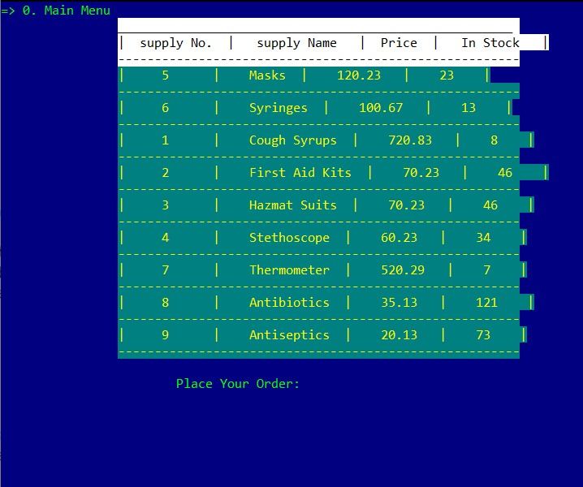
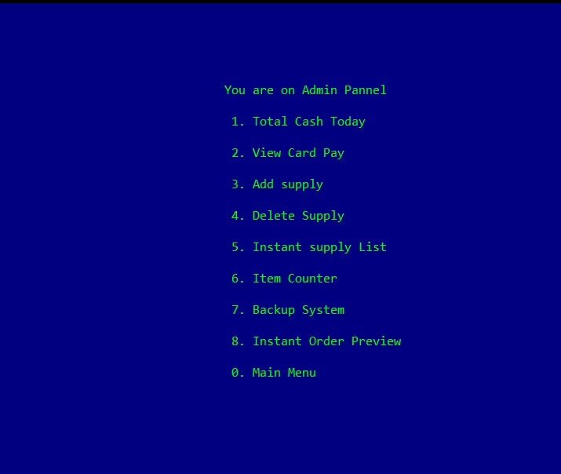
Screenshots

Slide 16
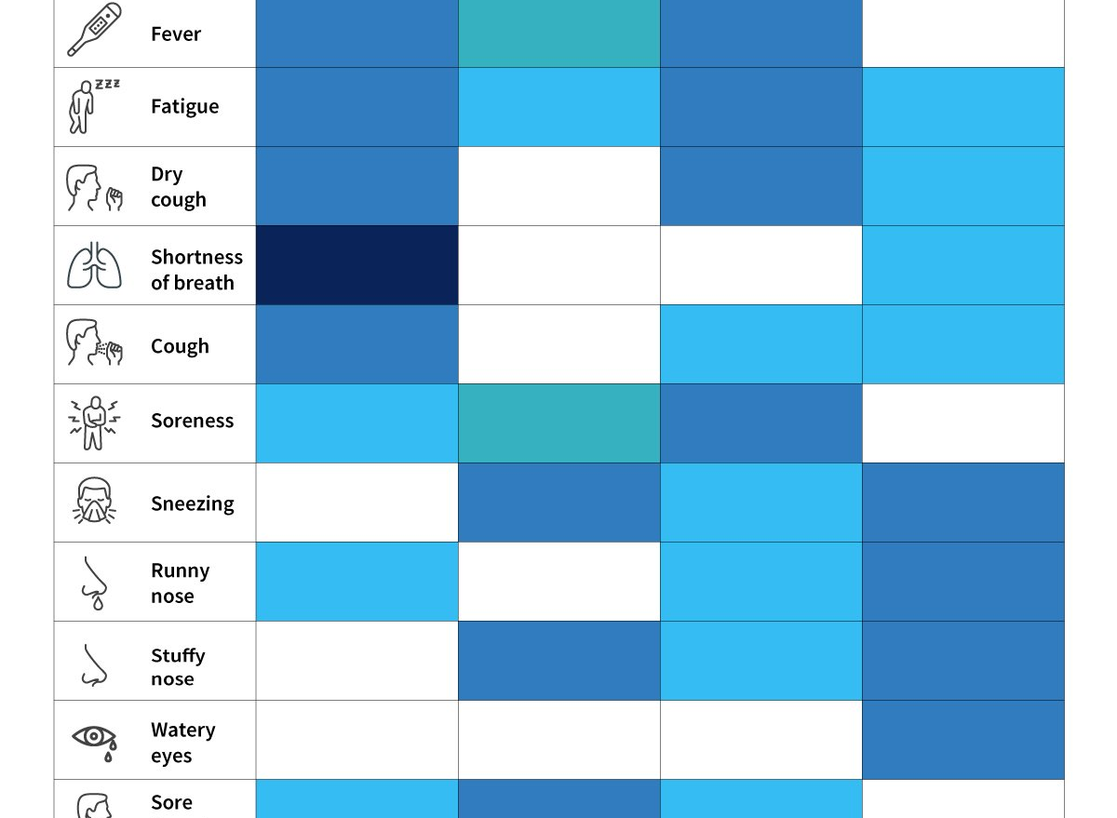
Symptom Checker
The Symptom Checker helps in diagnosing the user for COVID 19 with the help of Machine Language.The user will be asked several question related to finding about the existence of the above mentioned symptoms, and based on the input, the system will decide if the user has COVID 19 or not.The user input will be taken in as binary for easier comparison and will display the probability based on the input.

Slide 17
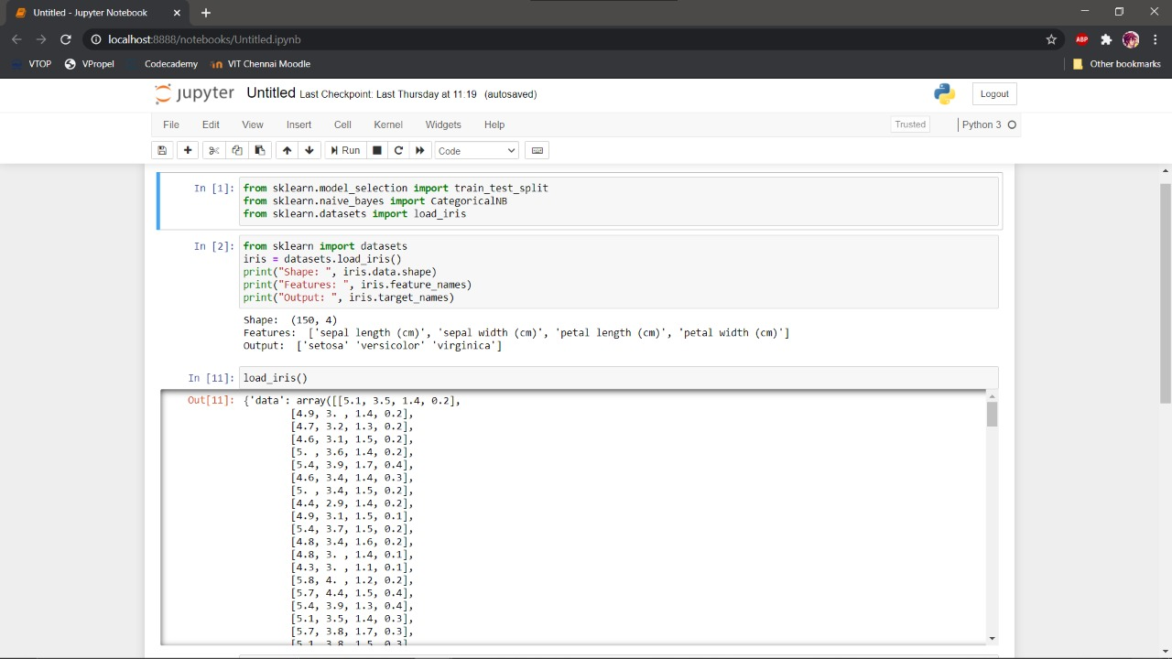
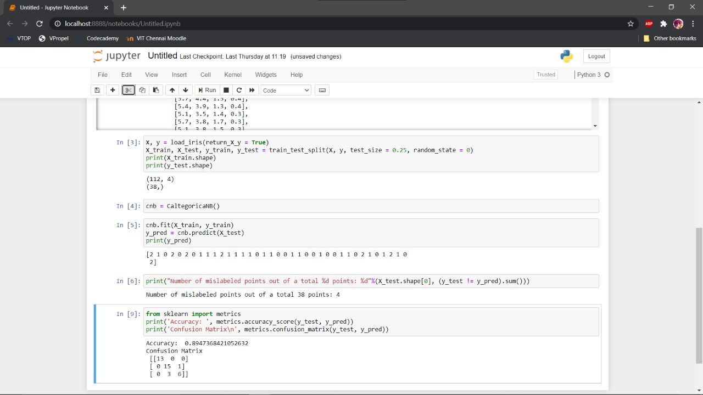

Slide 19
Progress
Project Review 2:
1)Chatbot has been added to the website to test modules linking with all functions and interactions operational.No plugins needed.Google Key API to be added 15 days before final review so as to last the trial period
2)Website has been made to accomodate access to all modules.
3)Program for our Medical Management System has been succesfully implemented.Addition of command prompt to run program in html yet to be added.
4)Machine Learning Notebook still in testing phase with other subjects for our Symptom Checker.

Slide 20
THANK YOU
Sir for hearing our idea and we will welcome any suggestions,including possible additions to the J-Component.

